Slide 1
Challenges and Disparities Faced by LGBTQ+ Students in the Transition to College
Survey Evidence from the California High School Class of 2023
This research was supported by the College Futures Foundation and conducted in partnership with the California Student Aid Commission. The authors are also grateful for ongoing support from the Stuart Foundation to the California Education Lab. The California Education Lab at the University of California, Davis and Policy Analysis for California Education are also thankful for research dissemination support from the Bill & Melinda Gates Foundation. The findings and conclusions here are those of the authors alone and do not necessarily reflect the positions or policies of the funders or of the California Student Aid Commission.

Slide 2
Overview
This project utilizes a large student survey to explore how LGBTQ+ high school students define and express their identities, and the challenges they face in the transition to college.
Motivation
Methodology
Data
Results
Discussion

Slide 3
Motivation
The high school to college transition is crucial for young adults (Luh et al., 2023)
Schools shape students’ perceptions of college and future educational attainment (Lynn et al., 2010; Uwah et al., 2008)
Existing research documents differences in outcomes among historically underserved groups
Limited evidence regarding LGBTQ+ students
This study provides direct evidence on LGBTQ+ students’ experiences before college, focusing on supports, challenges, and disparities

Slide 4
Prior Research

Slide 5
Context
Pandemic
Remote start to high school
Significant portion of high school was conducted online
Policy changes in financial aid application submission
AB 469 (2021) mandates graduating high school seniors to complete a FAFSA or CADAA (with opt-out waivers)
Class of 2023 is first cohort
Heightened visibility of and backlash against LGBTQ+ people
Study conducted in California, diverse
Progressive
Conservative

Slide 6
Research Questions
How do high school students today define their own gender identity and sexual orientation?
Are there different patterns in experiences and aspirations among sexual and gender minority students?
What are the challenges faced by sexual and gender minority students in the transition to college?

Slide 7
Contributions
Use validated survey instruments to collect nuanced data on gender identity and sexual orientation from a large sample of high school seniors
Recent surveys tend to draw on a narrow sample of students, students predominantly enrolled in earlier grades, or data collected pre-pandemic (Austin et al., 2023; Horowitz & Graf, 2019; Kosciw et al., 2022; Reber & Smith, 2023; YouScience, 2023)
Add to the growing literature on the academic and social experiences of LGBTQ+ students in high school and college (e.g., Austin et al., 2023; Feldman et al., 2023; Kosciw et al., 2022; Reber & Smith, 2023)
Contribute to the broader literature on the transition to college by adding new evidence on the experiences of underserved students

Slide 8
Methodology
Launched an internet-based survey in May 2023 in partnership with the California Student Aid Commission (CSAC)
Distributed by email to all high school seniors in California that submitted a Free Application for Federal Student Aid (FAFSA) or California Dream Act Application (CADAA) for the 2023-24 academic year
Response rate of 3.5% from
Convenience sample but large
Likert-scale questions
Students’ high school experiences, college preparation and plans, concerns about college
Demographic questions
Open-ended questions
Perceived challenges and excitement about college
Notes:
CSAC is the state agency that admins all state financial aid programs
Class of 2023 is first cohort under mandated fafsa/cadaa
Students more likely to respond when it’s from CSAC, however, they may be less inclined to complete survey when they see non-financial aid related questions

Slide 9
Data
The raw sample includes a total of 10,221 responses
Our sample includes around 9,230 college-bound HS seniors
7,522 who reported gender identity
7,481 who reported sexual orientation
Our sample includes 1,828 LGBTQ+ students (excluding Prefer Not to Say)
417 who we classify as being non-cisgender
1,782 who we classify as being non-heterosexual

Slide 10
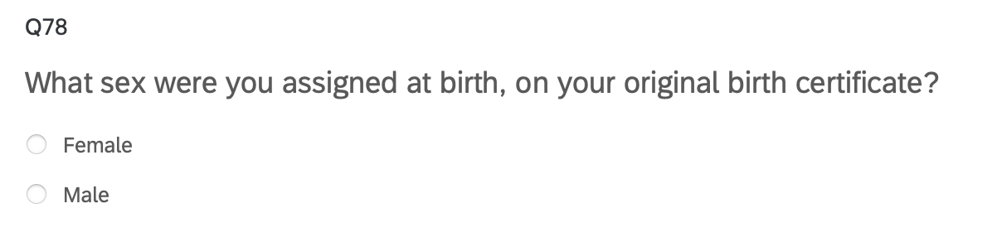
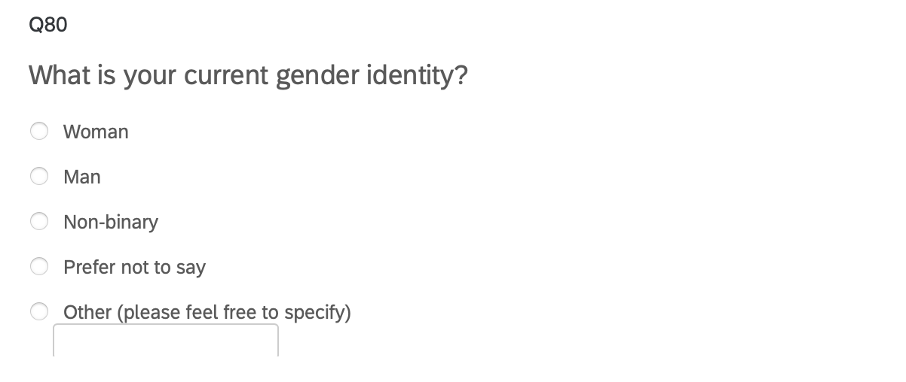
Survey Instrument: Gender Identity
“Two-Step” Approach recommended by Williams Institute

Slide 11
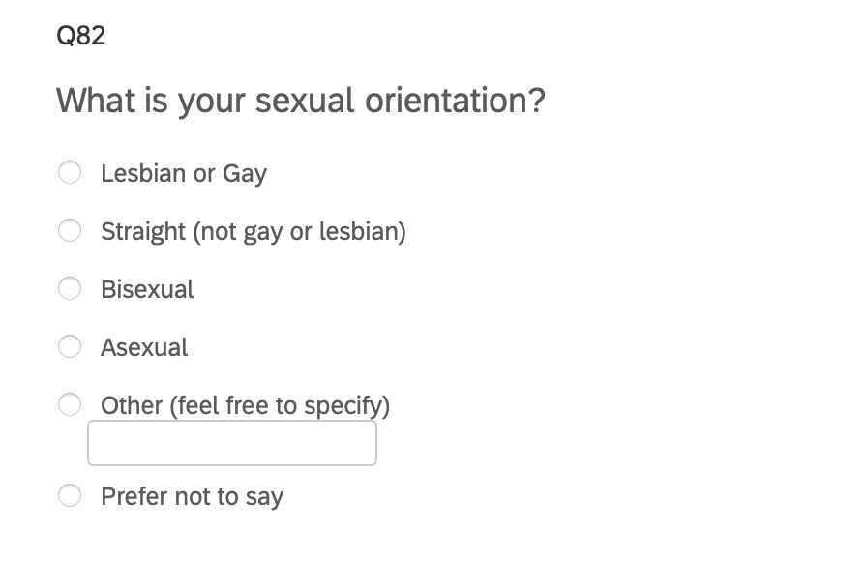
Survey Instrument: Sexual Orientation
Adapted from recommendations by the Williams Institute to allow for broader range of expressions

Slide 12
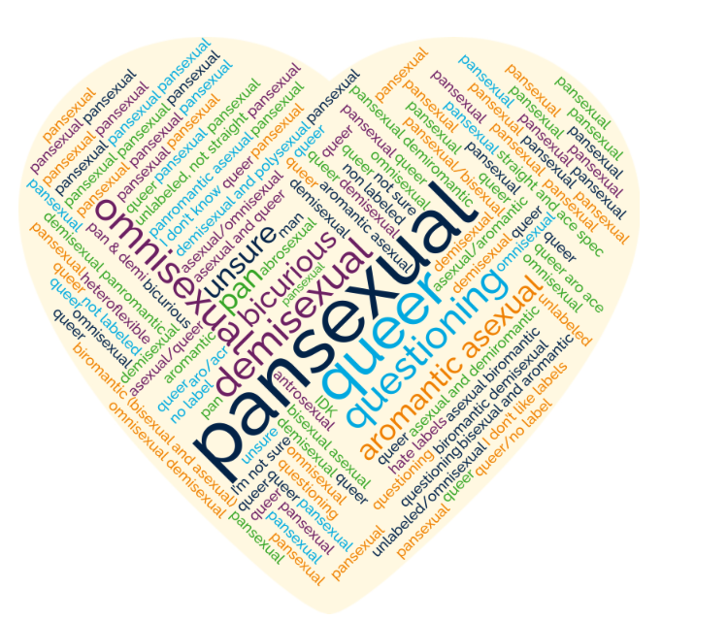
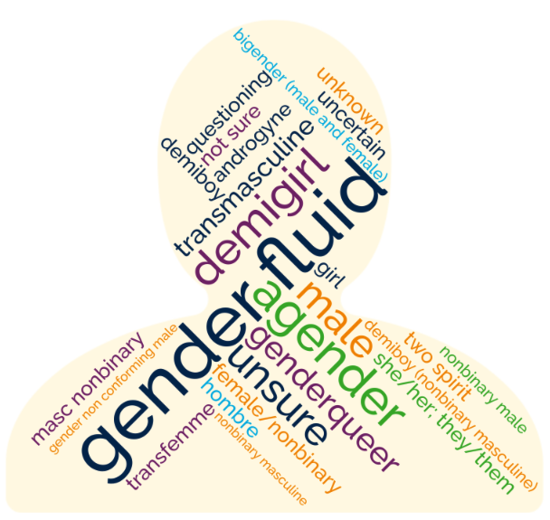
Gender and sexuality diversity
Students who chose to self describe used a diversity of descriptors
25 unique words to describe gender identities
47 unique words to describe sexual orientations

Slide 13
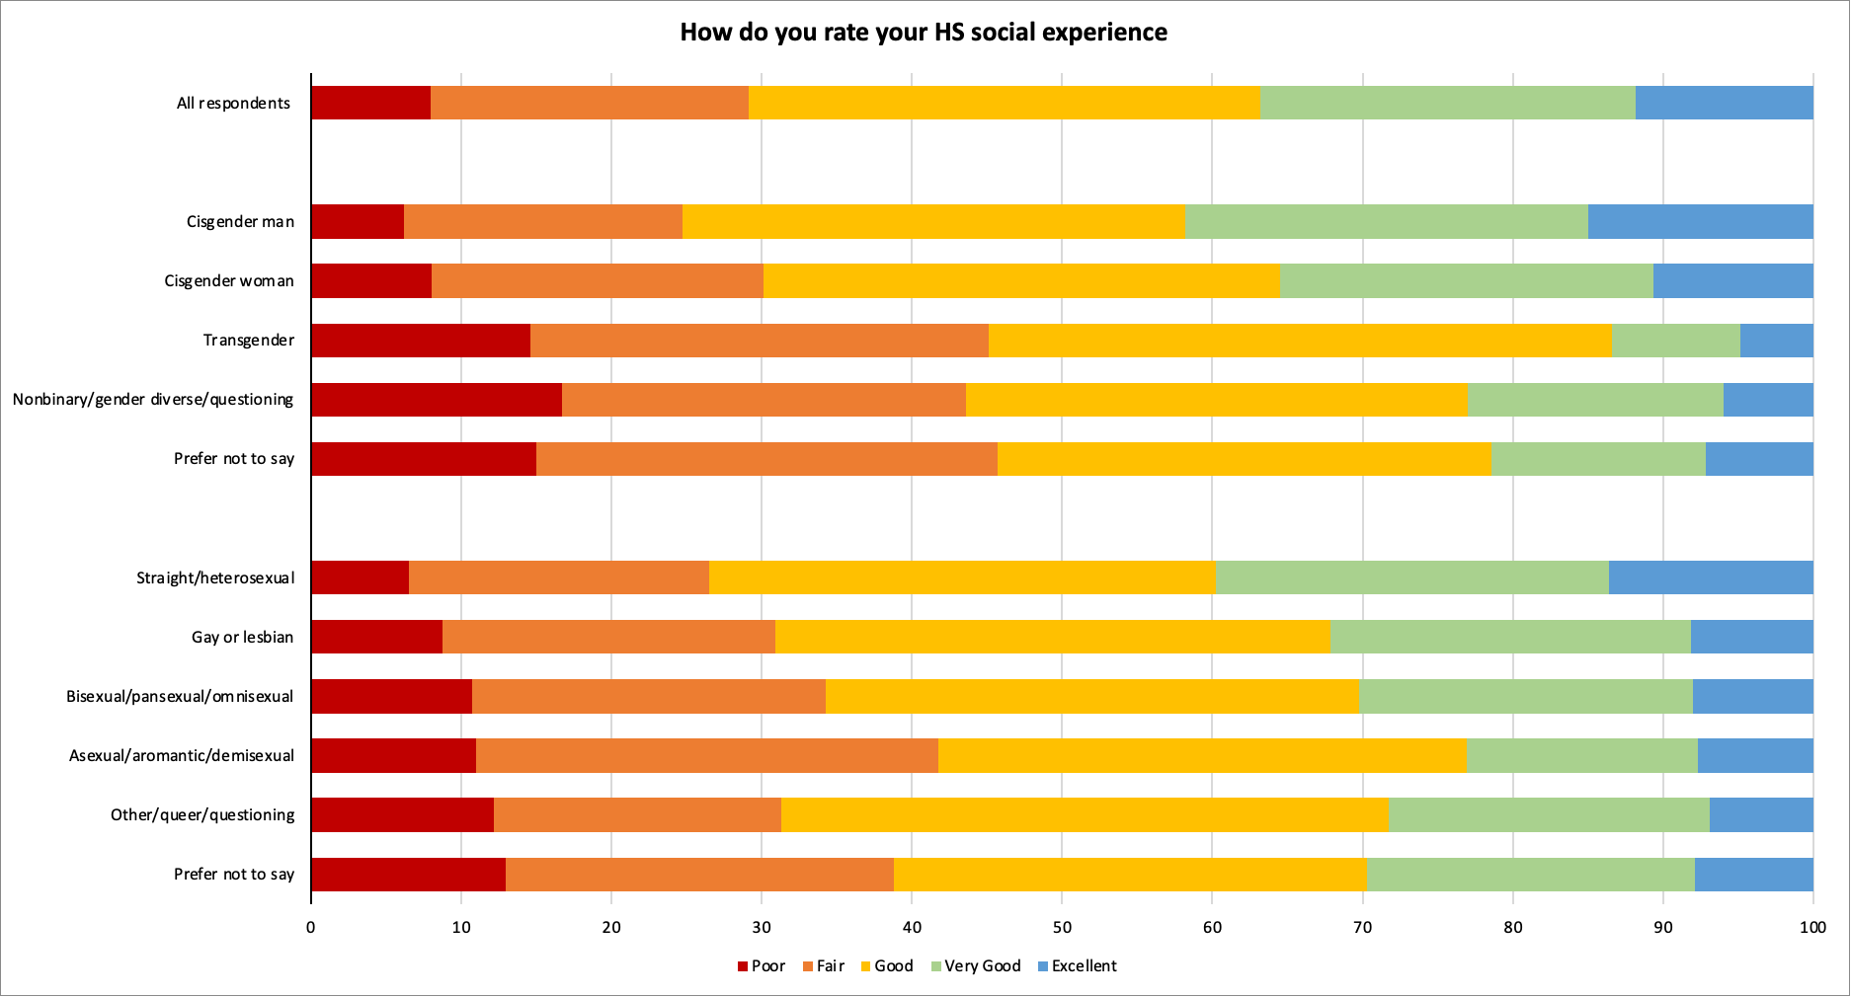
Result 1: Transgender students and gender diverse students more likely to report having a Poor or Fair social experience in high school.

Slide 14
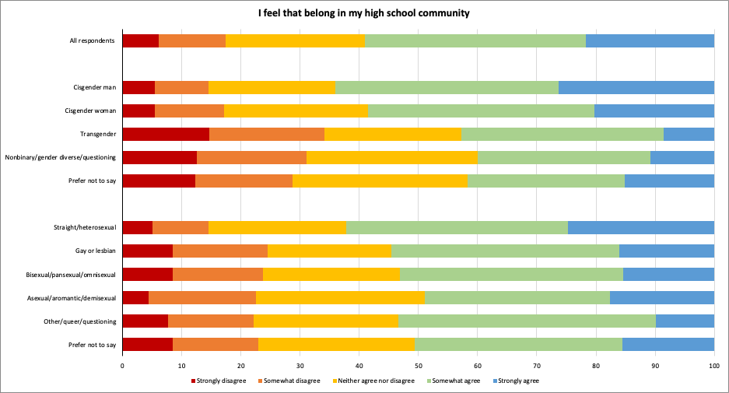
Result 2: Gender and sexual minority students are less likely to report a sense of belonging in their high school community.

Slide 15
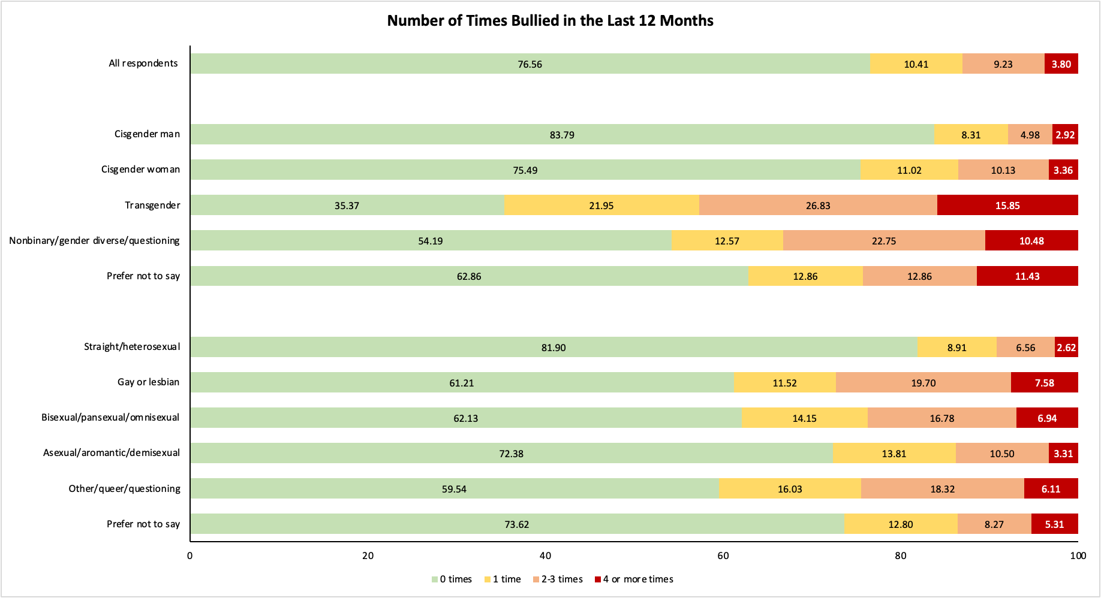
Result 3: Transgender students are the most likely to have been bullied in the last 12 months. Cisgender and straight students are least likely to be bullied.

Slide 16
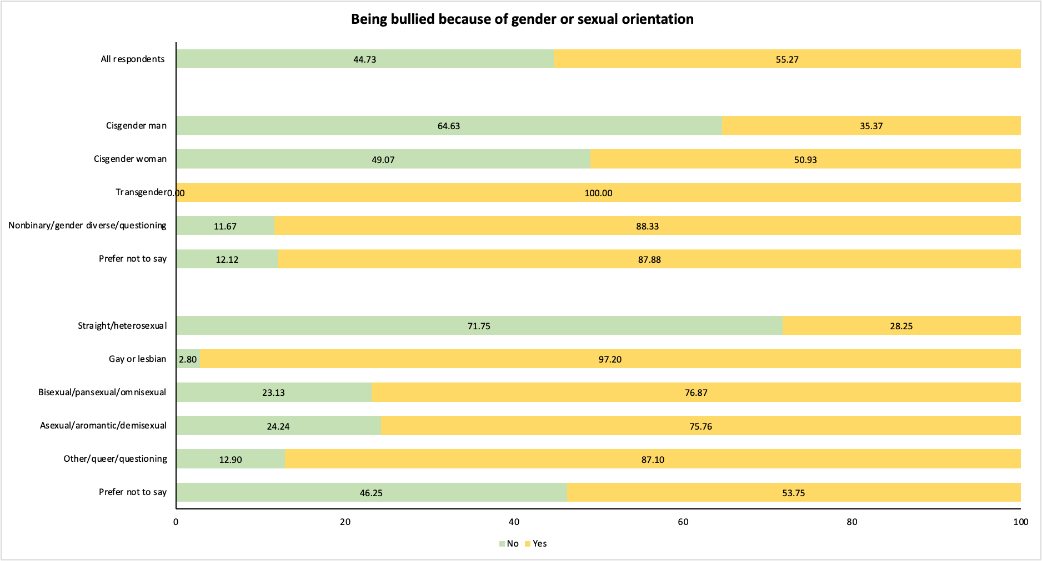
Result 4: Of the students report being bullied, transgender students are exclusively bullied because of gender or sexual orientation.

Slide 17
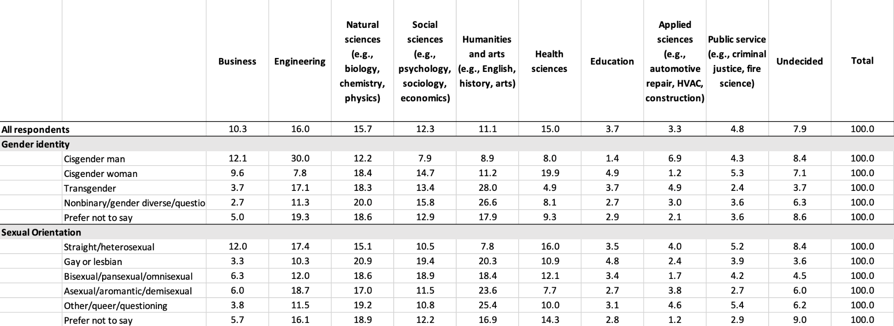
Plans for College: Major

Slide 18
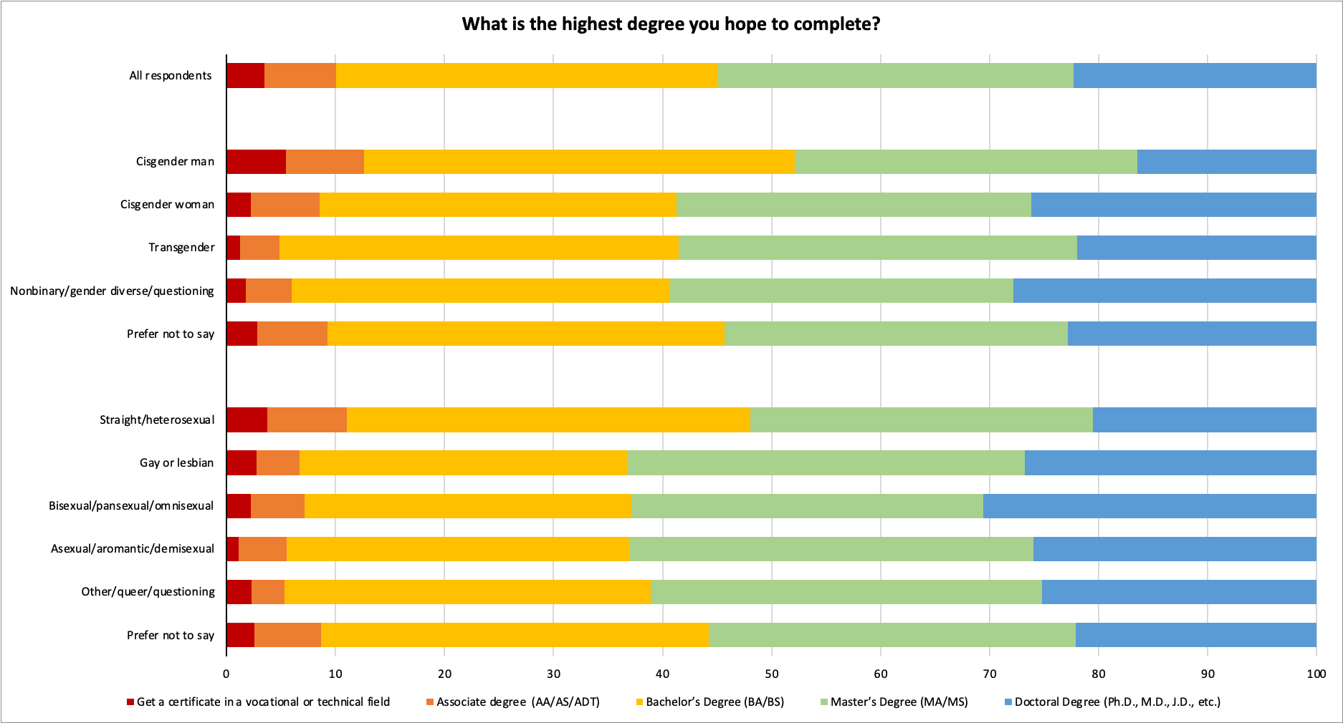
Educational Aspirations

Slide 19
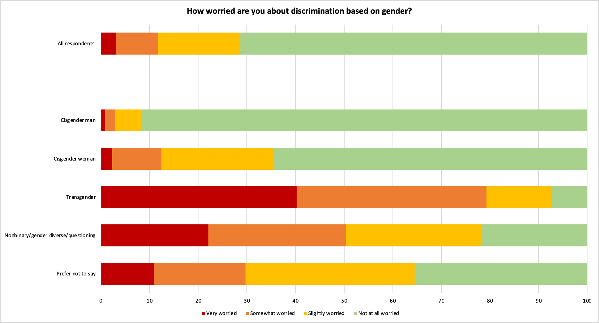
Worries about College: Discrimination on Gender

Slide 20
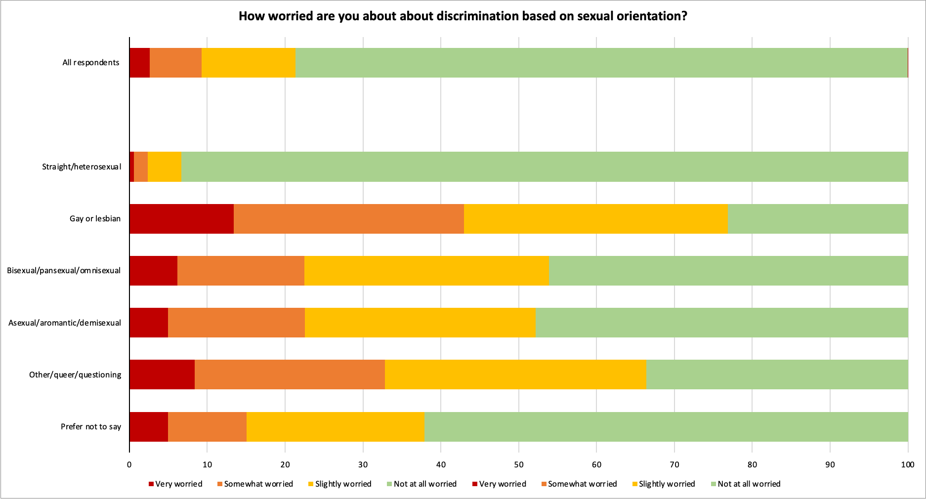
Worries about College: Discrimination on Sexuality

Slide 21
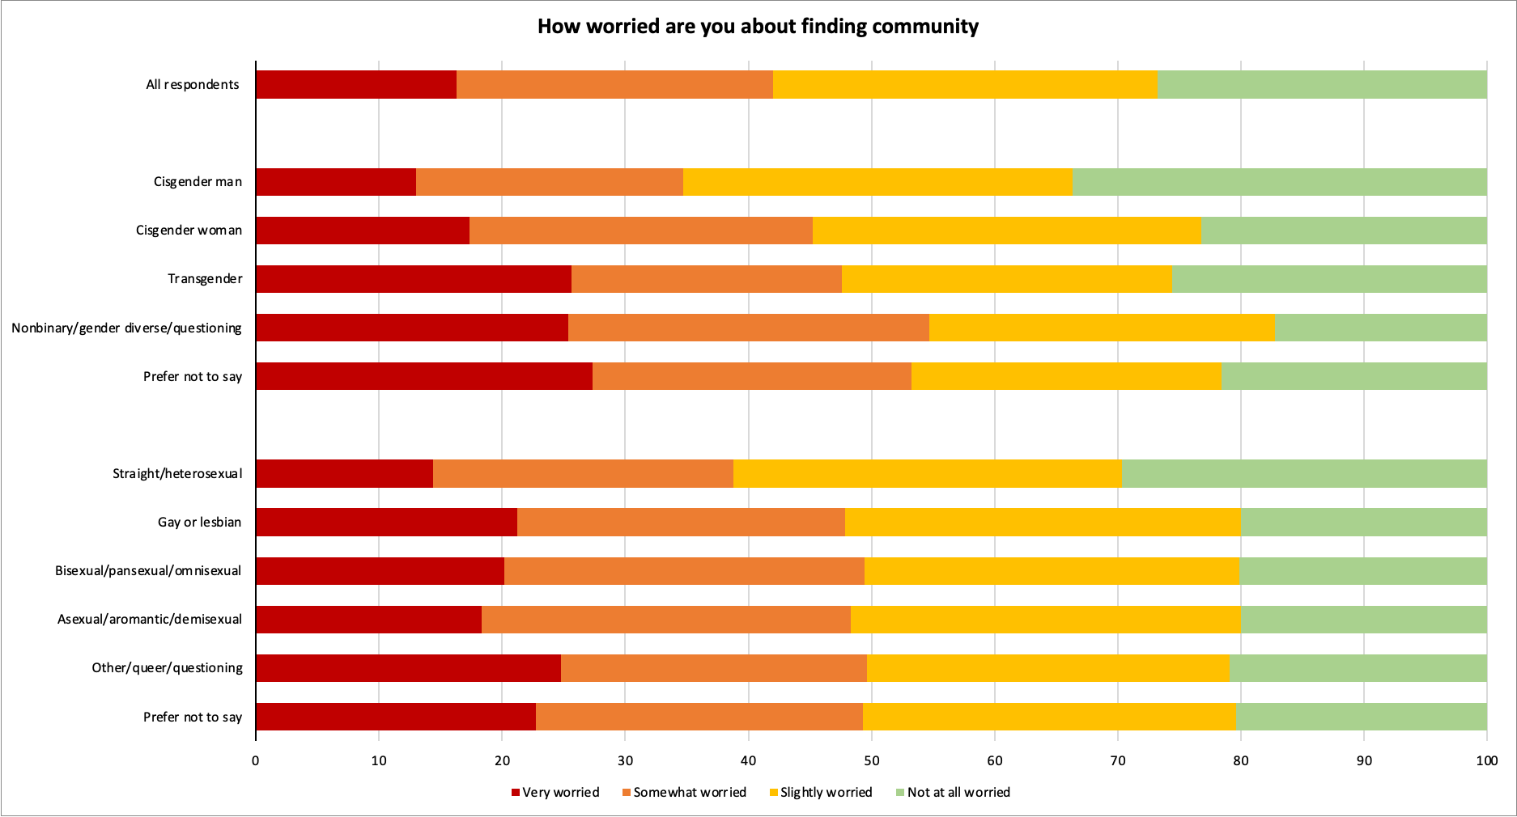
Worries about College: Finding Community

Slide 22
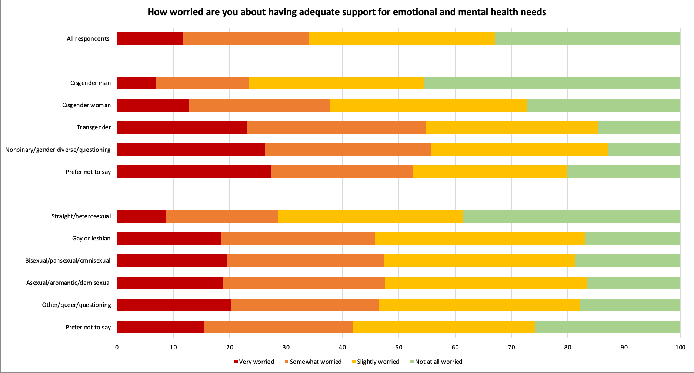
Worries about College: Support

Slide 23
Student Voice
“What are you most excited about college?”
“What do you think is the biggest challenge you’ll face in college?”
“TRANSPHOBIA”
“POLITICAL AND SOCIAL CONFLICTS. I COULD DIE FROM HATE CRIMES, BUT IT'S MORE LIKELY THAT I END UP KILLING MYSELF. I STRUGGLE A LOT WITH BEING TRANS AND IF NOT ABLE TO TRANSITION IN COLLEGE, I'M GOING TO GIVE UP ON EVERYTHING. THE POLITICAL CLIMATE IN TAIWAN COULD REACH A TIPPING POINT WHILE I AM IN COLLEGE. IF THAT HAPPENS, I AM LIKELY GOING TO DROP EVERYTHING TO HELP MY FAMILY.”
“LACK OF COMMUNITY DUE TO DISCRIMINATION”
“I THINK THE BIGGEST CHALLENGE WILL BE STANDING UP FOR MYSELF.”
“BEING ABLE TO BUILD A COMMUNITY FOR MYSELF WHERE I TRULY FEEL THAT I BELONG.”
“I'M EXCITED TO BE MYSELF. I LIVE IN A HOUSE OF FIVE. I'M THE YOUNGEST OF MY THREE SIBLINGS, MEANING I'VE HAD TO SHARE A ROOM WITH MY 23 YEAR OLD SISTER SINCE I WAS BORN. I'VE NEVER HAD PRIVACY AND I NEVER FELT LIKE I COULD BE MYSELF. TO USE BROAD TERMS, I COULD NEVER PROPERLY EXPRESS MYSELF AS A GAY, TRANS TEEN. I CAN'T WAIT TO MAKE NEW FRIENDS AND ENJOY MY NEW FOUND INDEPENDENCE.
“I’M [EXCITED] ABOUT MOVING FROM HOME AND WORKING TO ESTABLISH MY INDEPENDENCE.”

Slide 24
Key Takeaways

Slide 25
Thank You!
California Education Lab
Elizabeth Friedmann
Sherrie Reed
Paco Martorell
Scott Carrell
California Student Aid Commission
Marlene Garcia
Jessica Moldoff
Ryan Fuller
This research was supported by the College Futures Foundation and conducted in partnership with the California Student Aid Commission. The authors are also grateful for ongoing support from the Stuart Foundation to the California Education Lab. The California Education Lab at the University of California, Davis and Policy Analysis for California Education are also thankful for research dissemination support from the Bill & Melinda Gates Foundation. The findings and conclusions here are those of the authors alone and do not necessarily reflect the positions or policies of the funders or of the California Student Aid Commission.

